Slide 1
Broadband Wireless Channel Modeling
Module 2

Slide 2
WSSUS Channel Modeling
WSSUS Channel Modeling
WSS = Wide-Sense Stationary
US = Uncorrelated Scattering

Slide 3
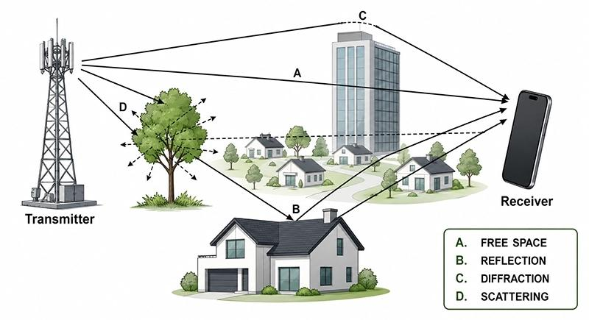
WSSUS Channel Modeling
What is a Wireless Channel?
A wireless channel is the path through which a signal travels from Transmitter (Tx) to Receiver (Rx).
The signal may reach the receiver through different paths.
This happens because of reflection, diffraction and scattering.
As a result, the received signal may become weak or distorted.

Slide 4
What is WSSUS?
WSSUS = Wide-Sense Stationary + Uncorrelated Scattering
It is a model used to understand how a wireless signal behaves while travelling from transmitter to receiver.
WSS – Wide-Sense Stationary
The overall behavior of the channel does not change much for a short time.
Signal conditions are considered almost stable for a short period.
The average signal strength and other statistical properties remain nearly the same.
Real-life example:
Imagine you are sitting in your classroom and using your mobile phone.
You are sitting at the same place.
The walls, benches, and other surroundings are not changing much.
For the next few seconds, the mobile signal conditions remain almost the same.
Therefore, we assume that the wireless channel is stable for that short time.
This is called Wide-Sense Stationary (WSS).
WSS means the wireless channel behaves almost the same for a short period of time.

Slide 5
Uncorrelated Scattering (US)
The signal can reach the receiver through different paths, and these paths are considered independent of each other.
For example:
Building
↗
Mobile 📱 ───────────────→ 📡 Receiver
↘
Vehicle
The signal reaches the receiver through:
Path 1: Direct path
Path 2: Reflection from building
Path 3: Reflection/scattering from vehicle
These different paths are treated as uncorrelated (independent).
US means signals coming through different paths behave independently.

Slide 6
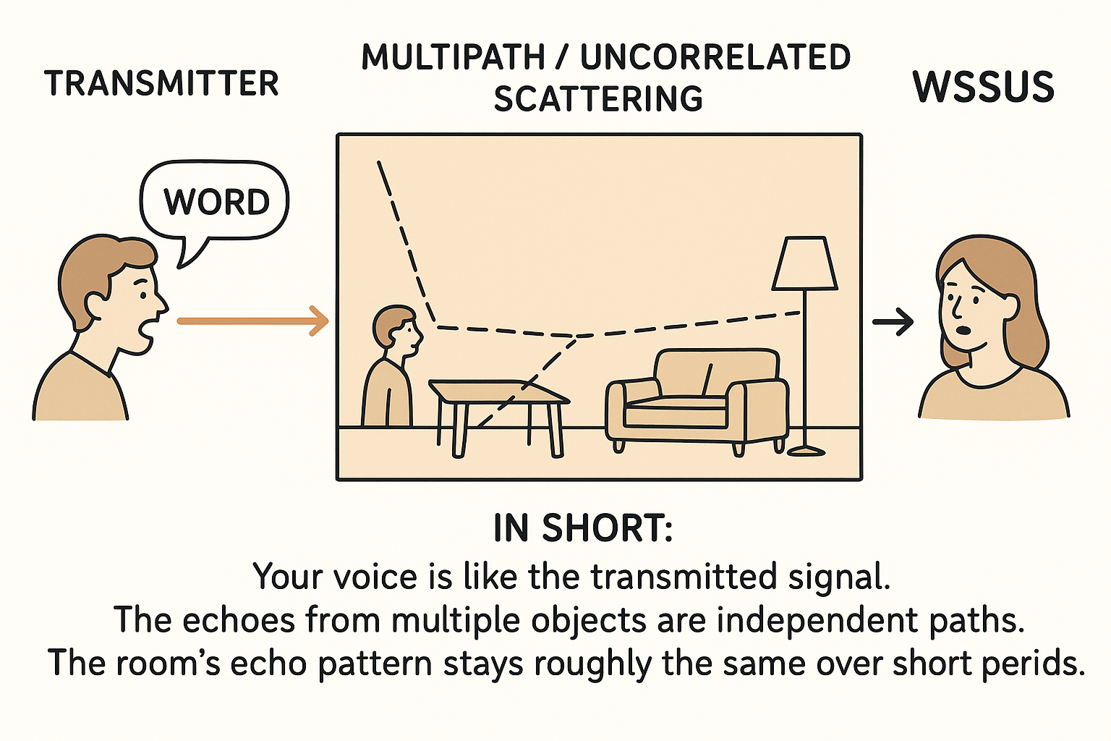
Transmitter: You shout a word.
Multipath / Uncorrelated Scattering: Your voice reaches your friend directly and also bounces off walls, table, and chair. Each bounce is independent.
WSSUS: The echo pattern stays roughly the same over short time (WSS), and each bounce is treated independently (US).

Slide 7
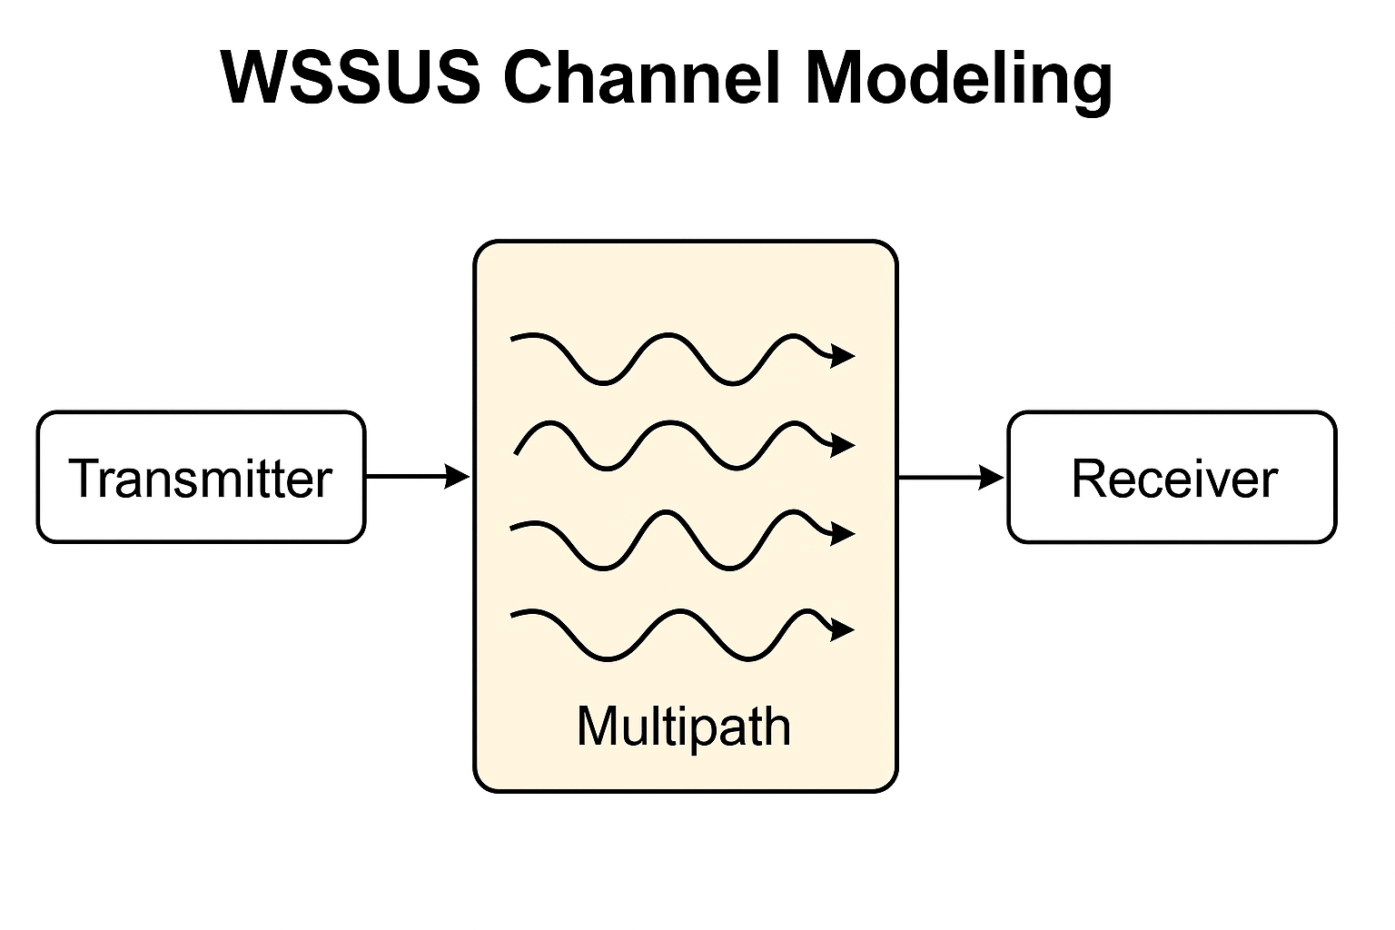

Slide 8
1. Transmitter
The starting point of the signal.
Example: Your mobile phone sending a WhatsApp message (signal goes out as radio waves).
2. Multipath (Signal Bouncing)
The signal does not travel in one clean path.
It bounces off objects like:
  Buildings
  Trees
  Cars
  Walls inside a room
So, at the receiver, we don’t get one signal but many copies, each:
  arriving late or early (delay)
  becoming strong or weak (strength)
  possibly flipped in phase (phase difference).
In WSSUS model:
Each bounced copy is independent (Uncorrelated Scattering).
The overall behavior doesn’t change much in short time (Wide-Sense Stationary).
3. Receiver
Collects all those copies mixed together.
It then uses special techniques to rebuild the original message.
If copies overlap in a bad way → fading (signal becomes weak).
If they overlap nicely → constructive addition (signal becomes stronger).

Slide 9
WSS – Wide-Sense Stationary
WSS means the channel behaves almost the same over a short period of time.
Small changes can happen, but the overall behavior remains similar.
The average value (mean) remains almost the same.
The signal power/variation (variance) remains almost the same.
The similarity between signals at two different times (correlation) depends mainly on how much time has passed, not on the exact time.
Real-Life Example: Fan Sound
Think about a fan running continuously in your room.
The fan produces almost the same average sound → Mean remains same.
The loudness does not suddenly become very high or very low → Variance remains almost same.
Compare the fan sound now and after 2 seconds. Their similarity depends on the 2-second gap, not whether it is 10 AM or 11 AM → Correlation depends on time difference.
WSS means: The overall behavior stays almost the same with time, even though small changes may occur.

Slide 10
RMS Delay Spread
RMS Delay Spread tells us how much a signal spreads in time because it travels through different paths.
Some signal parts arrive early, while others arrive late due to reflections and echoes.
It shows how much the signal is “spread or smeared” in time.
Real-Life Example
Imagine shouting “HELLO” in a large hall:
HELLO → HELLO → HELLO
The original sound arrives first, and reflected sounds arrive a little later.
Similarly, in wireless communication, the same signal can arrive at different times.
Effect on Communication
Higher RMS Delay Spread → More signal spreading → More ISI → More errors
Low delay spread: Signal arrives almost together → Less ISI
High delay spread: Signal arrives at different times → More ISI
RMS Delay Spread measures how much a wireless signal is spread in time due to multipath propagation.

Slide 11
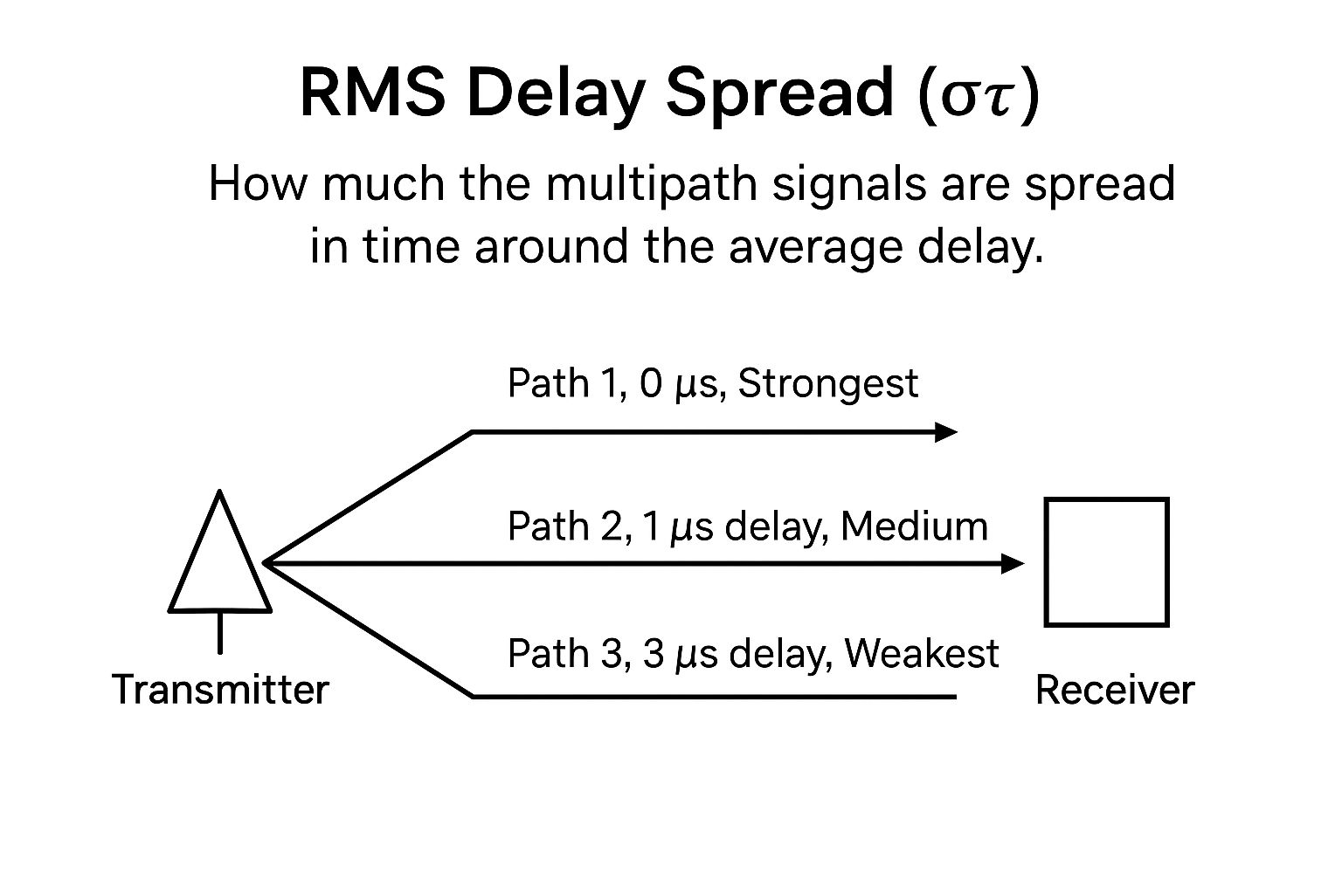

Slide 12
Diagram shows how a signal from a transmitter reaches the receiver through multiple paths:
Path 1 → arrives first (0 µs delay), strongest signal.
Path 2 → arrives slightly later (1 µs delay), medium strength.
Path 3 → arrives much later (3 µs delay), weakest signal.
These different arrival times create a spread in delays, which is measured as RMS Delay Spread (στ).
It tells how much the signals are spread around the average delay.

Slide 13
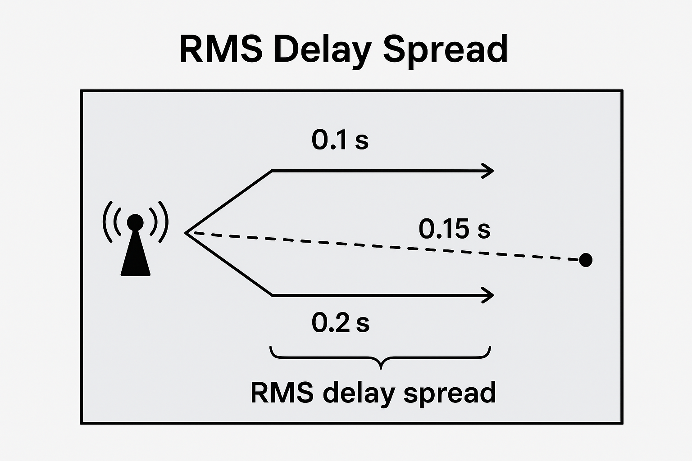

Slide 14
RMS Delay Spread Numerical
A transmitter sends a signal, and the receiver gets two multipath components:
Path 1 arrives at τ₁ = 0.1 s
Path 2 arrives at τ₂ = 0.2 s
Assume both paths have equal received power (P₁ = P₂ = 1).
Find:
Mean Excess Delay (τ̄)
RMS Delay Spread (στ​)

Slide 15
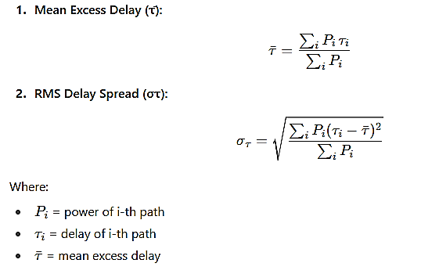

Slide 16
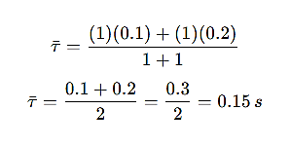
Step 1: Mean Excess Delay
So, mean delay = 0.15 s

Slide 17
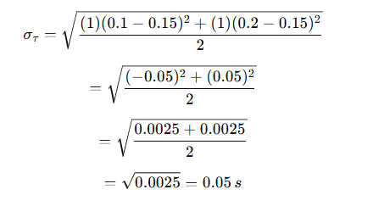
Step 2: RMS Delay Spread
Mean Excess Delay (τ̄) = 0.15 s
RMS Delay Spread (στ) = 0.05 s

Slide 18
A receiver detects three multipath components from a transmitter. The delays and received powers are:
Calculate:
Mean Excess Delay (τ̄)
RMS Delay Spread (στ​)
Path | Delay (τᵢ) in µs | Power (Pᵢ)
1 | 0 | 0.5
2 | 2 | 0.3
3 | 5 | 0.2

Slide 19

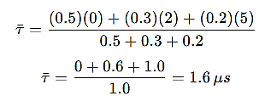
Mean Excess Delay (τ̄):

Slide 20

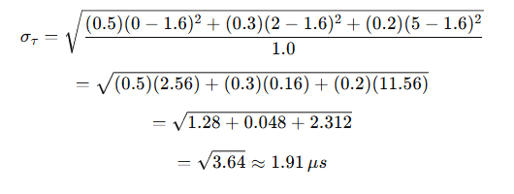
RMS Delay Spread (στ):
Mean Excess Delay (τ̄) = 1.6 µs
RMS Delay Spread (στ) = 1.91 µs

Slide 21
Doppler Fading
When the mobile or receiver is moving, the received signal frequency changes. This is called the Doppler Effect.
Due to this, the signal strength goes up and down (fading).
This changing signal strength is called Doppler Fading.
Example
A person is listening to FM radio while travelling in a moving car.
As the car moves, the radio signal changes.
The sound may become clear → weak → clear.
This happens because of changes in the received signal due to motion.
Doppler fading is the variation in signal strength caused by the movement of the transmitter or receiver.

Slide 22
Impact of Doppler Fading
Signal Strength Changes → The signal becomes strong and weak quickly.
Frequency Shift → Causes errors in decoding at the receiver.
Fast Fading → If speed is high (like in a car/train), fading happens very rapidly.
Reduced Data Quality → Leads to distortion, call drops, or lower internet speed.
Example:
When you are on a fast-moving train, your mobile call or internet may break or fluctuate. This is due to Doppler fading.

Slide 23
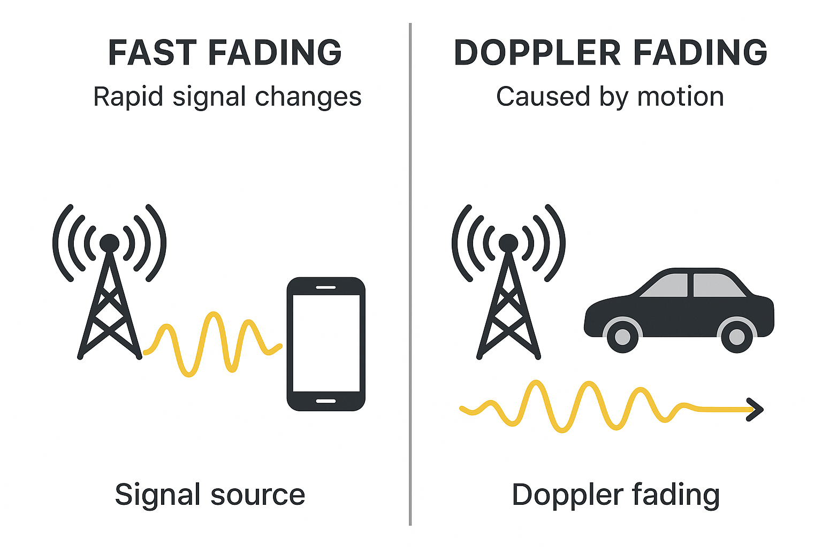

Slide 24
Jakes Model
Jakes Model is a method used to simulate wireless signal fading.
It shows how the signal strength changes because of:
  Multiple paths (reflections)
  Doppler effect (movement)
Widely used for Rayleigh fading simulation.
Example
A person travelling in a car may receive signals reflected from buildings and vehicles.
Due to movement, the signal strength changes strong → weak → strong.
Jakes Model creates this type of signal variation in a computer simulation.
Jakes Model is a mathematical method used in computers to imitate the signal fluctuations caused by multipath and movement.

Slide 25
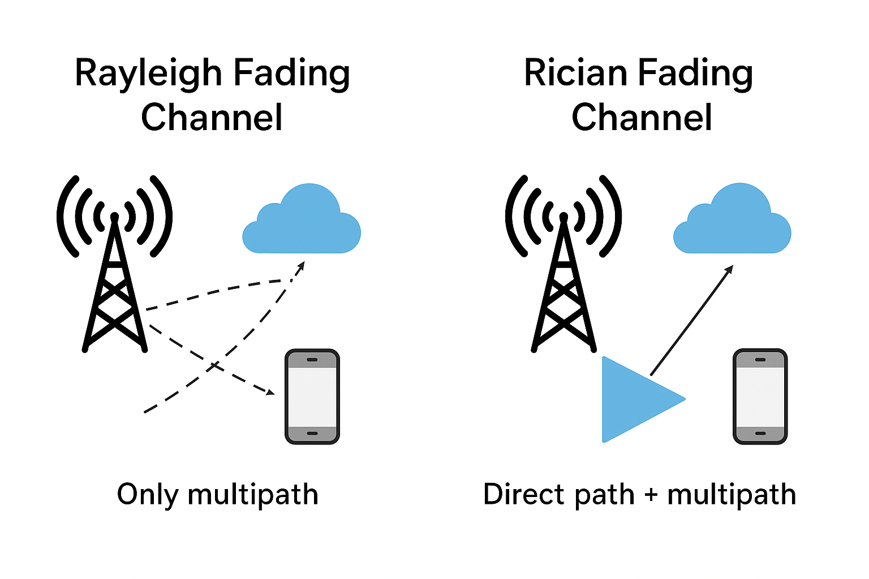
Fading Channel Types

Slide 26
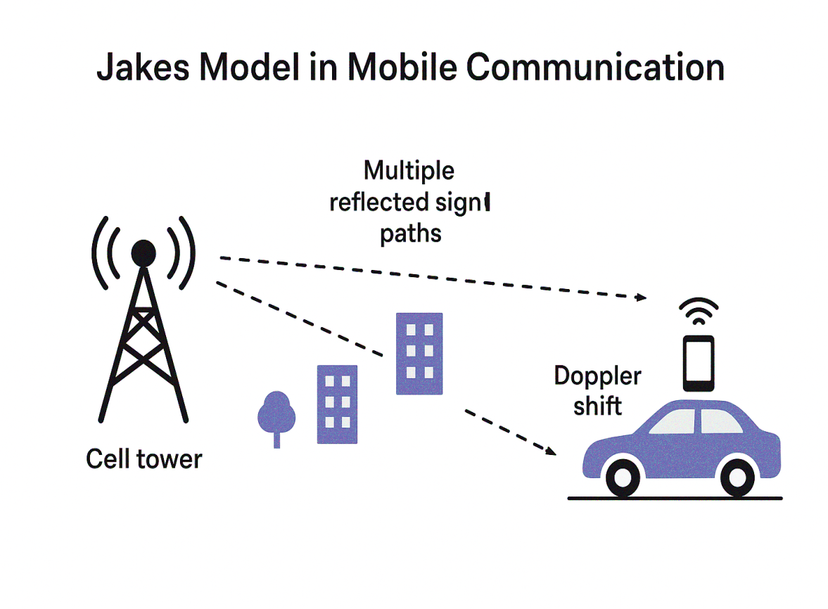
The diagram shows that signals from
a cell tower reach a moving mobile
through many reflected paths. Because
the car is moving, the received
frequency shifts (Doppler effect).
Jakes Model is used to simulate and
predict this fading behavior in mobile
communication.
What Jakes Model Does
Jakes Model is used to
simulate fading in mobile communication.
It explains how signals
weaken, strengthen, or fluctuate because of:
  Multipath reflections
  Doppler effect (movement)
Helps engineers design reliable wireless systems (like 4G/5G).
Jakes Model mathematically shows how a mobile signal fades due to reflections and Doppler shift when the user is moving.

Slide 27
Jakes Spectrum
It shows how a moving signal’s strength spreads over frequencies when it bounces off objects, helping design better mobile networks.
A car moving at 60 km/h gets signals reflected from buildings. Jakes Spectrum tells us how the power of these signals spreads across different frequency shifts caused by movement.
Jakes Spectrum shows how their frequencies spread.
Jakes Model = How to CREATE/SIMULATE fading
Jakes Spectrum = How to SEE/ANALYZE the frequency spread of fading

Slide 28
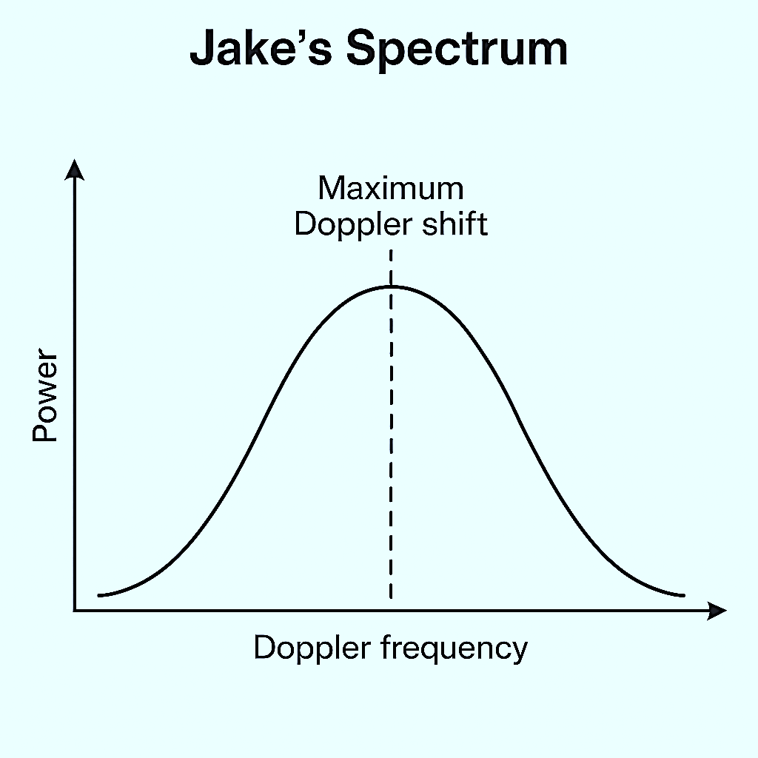
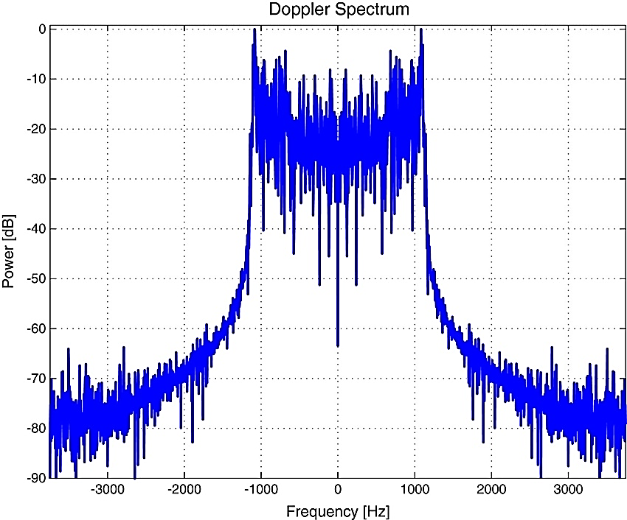

Slide 29
Autocorrelation
Autocorrelation shows how similar a signal is to itself after a time delay.
It helps to understand how fast or slow the wireless channel changes over time.
High Autocorrelation:
The signal does not change much with time.
The channel is slowly varying or stable.
Low Autocorrelation:
The signal changes quickly over time.
The channel is fast fading or rapidly varying.
Imagine you are listening to a radio while traveling in a car:
If the signal strength stays almost same as you move → High Autocorrelation.
If the signal strength changes up and down quickly → Low Autocorrelation.
In Short:
Autocorrelation = Signal similarity over time
It shows how stable or changing the wireless channel is.

Slide 30
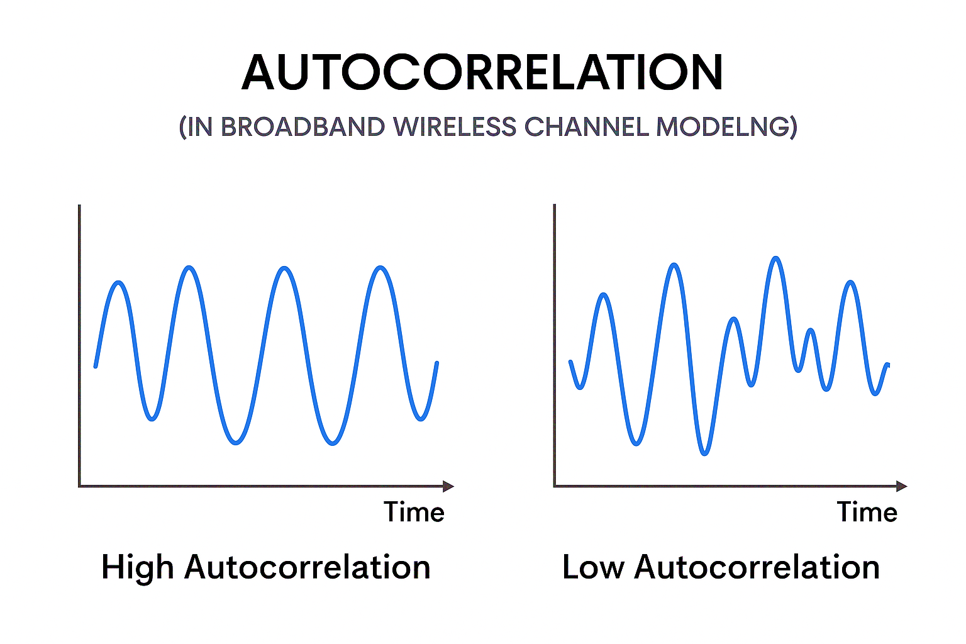
High Autocorrelation: Signal stays smooth and similar over time.
Example: Watching TV at home , the signal is stable because you are not moving.
Low Autocorrelation: Signal changes quickly and irregularly.
Example: Talking on mobile while traveling in a train, the signal keeps going up and down quickly.

Slide 31
Cellular Communications
Cellular Communication is a system where a large area is divided into small areas called cells, and each cell has a base station/tower to provide mobile communication.
Cell Concept:
The whole area (like a city) is divided into small zones called cells.
Each cell has its own base station (tower) that connects phones in that area to the network.
Why Divide into Cells:
To reuse frequencies in different cells.
To cover large areas with less power.
To reduce interference between users.
Main Parts:
Mobile Station (MS): Your mobile phone.
Base Station (BS): Tower that connects your phone to the network.
Mobile Switching Center (MSC): Connects different towers and manages calls/data.
How It Works:
You make a call → phone sends signal to nearest tower (base station).
Tower connects to switching center → switching center routes your call to the receiver’s tower → receiver’s phone gets connected.
Advantages:
Wide coverage
Better frequency use
Continuous service even when moving (mobility)
Real-Life Example:
When you travel and still talk on the phone without disconnection….that’s cellular communication at work.

Slide 32
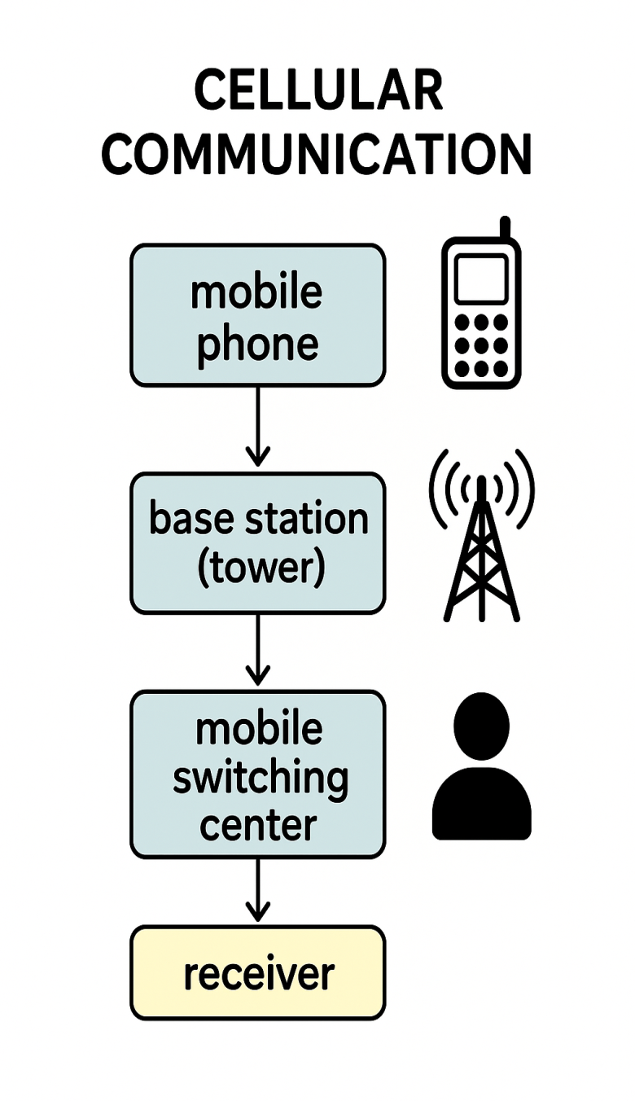
Mobile Phone
The user speaks or sends data (voice, text, internet).
The phone converts the voice/data into radio signals.
Base Station (Tower)
The tower receives the signal from the phone.
It sends the signal to the nearest switching center.
Mobile Switching Center (MSC)
Acts like a control hub.
It decides where the signal should go — to another phone or network.
Receiver (Other User)
The final user gets the signal as voice or data on their phone.

Slide 33
Frequency Reuse
It means using the same frequency in different areas (cells) of a network.
Why:
  To save frequency and increase capacity of the cellular network.
Limited frequencies → Mobile networks have limited frequency channels.
Area divided into cells → The whole area is divided into small parts called cells.
Different frequencies for nearby cells → Neighboring cells use different frequencies to avoid mixing signals.
Same frequencies reused far away → Distant cells can use same frequencies again safely.
This reuse saves spectrum → It allows more users to talk at the same time using limited frequencies.
Cluster → A group of cells using all available frequencies is called a cluster.
Reuse distance → The distance between two cells using the same frequency.
Result:
  Efficient use of limited frequency bands.
  More users can communicate at the same time.
In short:
Same frequencies are reused in distant cells → saves bandwidth and increases coverage.

Slide 34
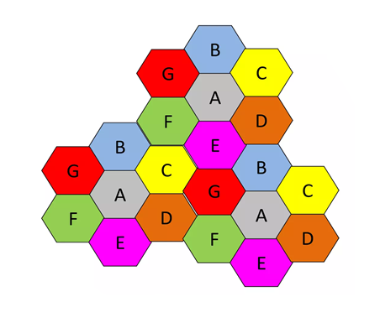
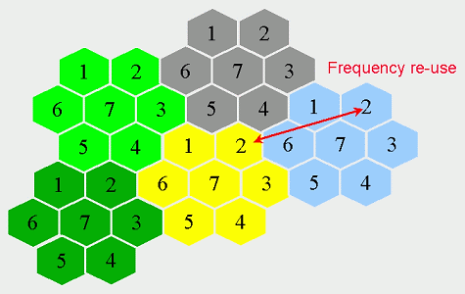
Frequency reuse means using the same frequencies again in different parts of a mobile network, but only in far-away areas so that signals don’t mix.
Cells with same letter use the same set of frequency channels.
Suppose there are 7 cells (A–G).
Each cell gets different frequencies.
After one cluster, the same A–G pattern repeats in another far area.
So, Cell A in cluster 1 and Cell A in cluster 2 use the same frequency — but they’re far apart, so no interference.

Slide 35
Multiple Access Technologies
Multiple Access Technologies allow many users to share the same network or frequency band.
Goal → To let multiple users communicate at the same time without interference.

Slide 36
Main Types Of Multiple Access Technologies
FDMA (Frequency Division Multiple Access)
Each user gets a separate frequency band.
Example: Like different radio stations using different frequencies.
.TDMA (Time Division Multiple Access)
All users share the same frequency but use it at different time slots.
Example: Like people talking one after another in turns.
CDMA (Code Division Multiple Access)
All users share the same frequency and time but use unique codes to separate signals.
Example: Many people talking at once, but each speaks a different language, so you understand your friend’s language only.
OFDMA (Orthogonal Frequency Division Multiple Access)
Frequency is divided into small sub-channels, and users get different sub-channels.
Example: Like dividing a highway into lanes, each user gets a lane to travel smoothly.
FDMA → Different frequency.
TDMA → Different time.
CDMA → Different code.
OFDMA → Different sub-frequencies (lanes).

Slide 37
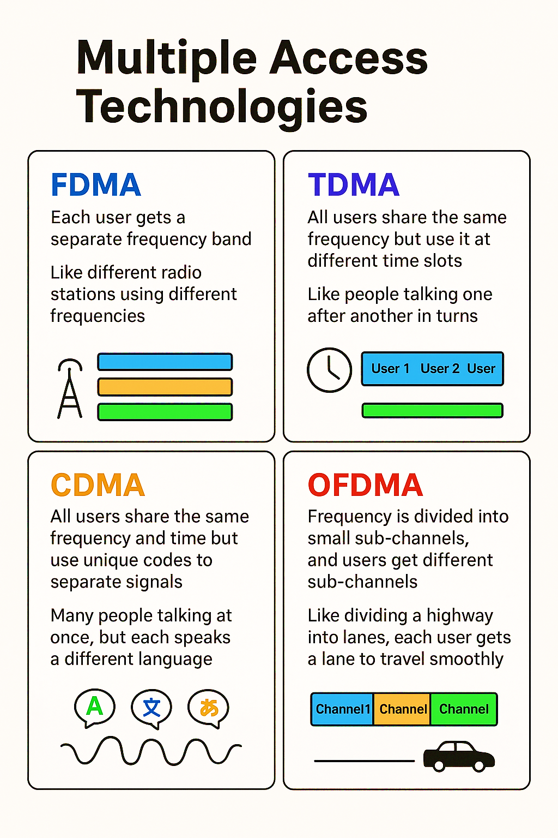

Slide 38
Cellular process
Cellular process means the steps or actions that happen inside a cellular network to make communication (like calls or data) work properly.
Used for: Making, maintaining, and ending calls or data connections.
🔸 Main cellular processes:
Call setup – starting a call.
Handover – moving a call between towers.
Call termination – ending a call.
Location update – phone tells the network where it is.
Roaming – using your phone in another network area.
Example:
When you call your friend while traveling -
your phone connects to the nearest tower (call setup),
switches to new towers as you move (handover),
and ends smoothly when you hang up (call termination).

Slide 39
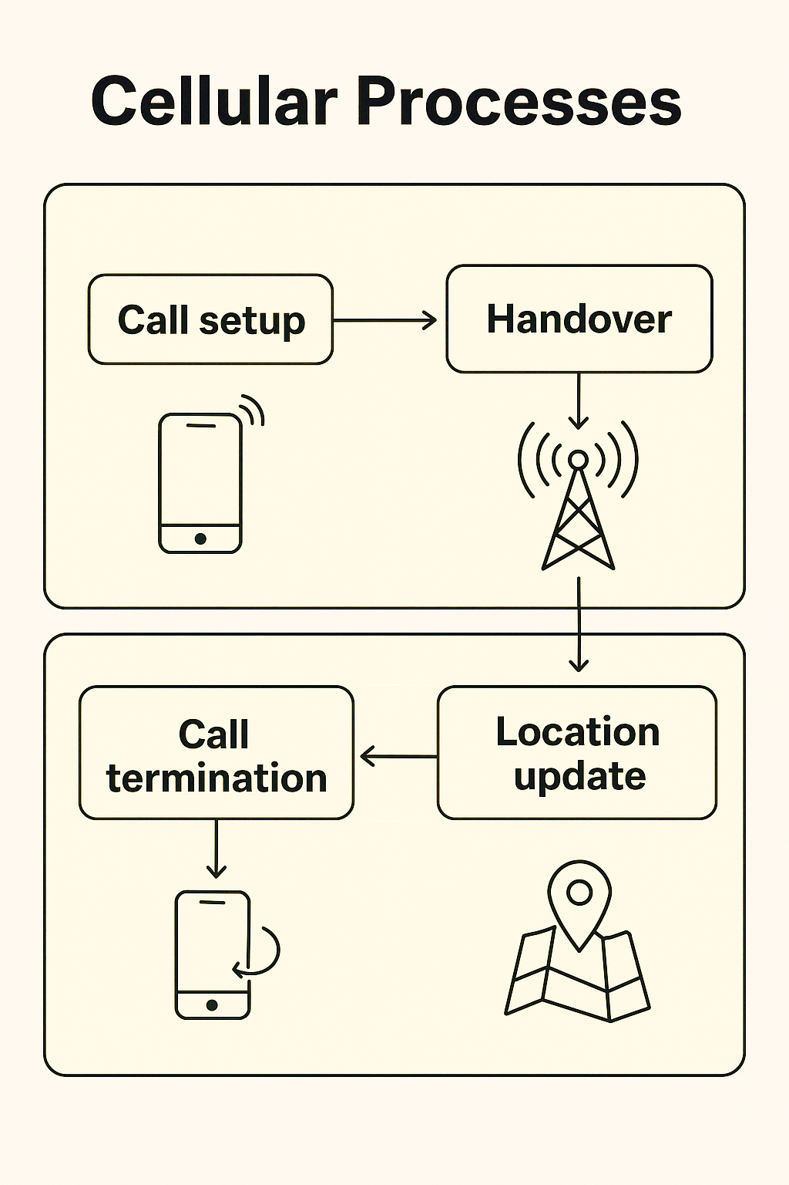

Slide 40
Call Setup (When a call starts)
User dials a number → The mobile sends a request to the nearest cell tower (Base Station).
Tower checks signal & availability → It finds an empty channel for communication.
Network connects both users → The Mobile Switching Center (MSC) connects the caller and receiver through available paths.
Call established → Voice/data starts flowing between both mobiles.
Example:
When you call your friend, your phone connects to the nearest tower → MSC finds your friend’s tower → connects both → call starts.

Slide 41
Handover (During a moving call)
User moves from one area to another while on a call.
Signal strength drops in the old cell and increases in the new cell.
Network transfers the call from the old cell tower to the new one without breaking the call.
Call continues smoothly with no cut.
Example:
You’re talking on your phone while traveling in a car the call continues as your connection shifts from one tower to the next (handover).

Slide 42
Teletraffic Theory
It’s the study of how phone calls or data traffic flow in a network.
Goal: To make sure the network can handle many users without delay or call drops.
Used for: Planning how many lines, channels, or towers are needed for smooth communication.
Main idea:
  Calls arrive randomly.
  Some calls are busy, some get blocked.
  The network must manage all efficiently.
Measured in: Erlang → a unit that measures traffic load (1 Erlang = one call for one hour continuously).
Example:
  A tower can handle 100 calls at once.
  If 120 users try calling, 20 calls may get blocked.
  Engineers use teletraffic theory to increase capacity or reduce blocking.
In short:
Teletraffic theory helps design a network so that most calls connect smoothly even when many users call at the same time.

Slide 43
Working of Teletraffic Theory
Call requests start:
Many users try to make calls at the same time → these are incoming calls.
Network receives calls:
The calls enter the network (like towers or switches) which has limited channels.
Some calls connect:
If free channels are available, calls are connected successfully.
Some calls get blocked:
If all channels are busy, new calls are blocked (can’t connect).
Blocking probability:
The network calculates how many calls are blocked shown as a percentage (example: 20% blocked).
Traffic measurement:
Total call load is measured in Erlangs to know how busy the network is.
Network improvement:
Engineers use this data to add more channels or towers to reduce blocking and improve service.
Example:
Suppose 100 people try to call at the same time.
80 calls are successfully connected → Outgoing calls
20 calls cannot connect because the network is busy → Blocked calls
Therefore, Blocking = 20%
This is how teletraffic theory studies network traffic and blocked calls.

Slide 44
